Slide 1

CIT-2180 Data and Database Management Chapter 1

Slide 2

Oracle 12c: SQL
Chapter 1
Overview of Database Concepts

Slide 3
Database Terminology
Database – logical structure to store data
Database management system (DBMS) – software used to create and interact with the database
3

Slide 4
Database Components (Think of a spreadsheet)
Character – basic unit of data
Field (or column) – collection of related characters
Record (or row) – collection of related fields
File (or table) – collection of related records
4

Slide 5
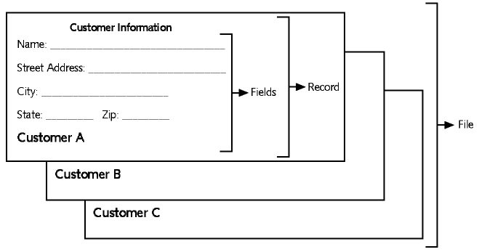
Components Example

Slide 6
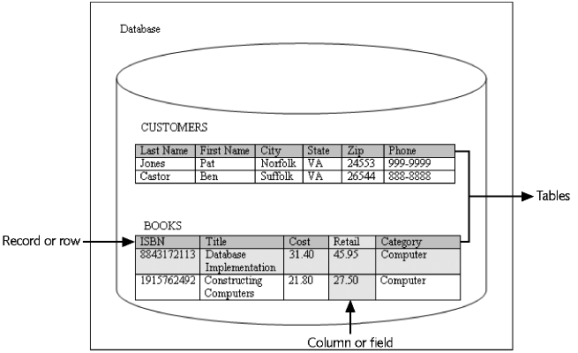
Database Example
6

Slide 7
Database Management System
Data storage: manage the physical structure of the database
Security: control user access and privileges
Multiuser access: manage concurrent data access
Backup: enable recovery options for database failures
Data access language: provide a language that allows database access
Data integrity: enable constraints or checks on data
Data dictionary: maintain information about database structure
7

Slide 8
Database Design
Systems Development Life Cycle (SDLC)
Entity-relationship model (E-R model)
Normalization
8

Slide 9
Systems Development Life Cycle (SDLC)
Systems investigation – understanding the problem
Systems analysis – understanding the solution
Systems design – creating the logical and physical components
Systems implementation – placing completed system into operation
Systems maintenance and review – evaluating the implemented system
9

Slide 10
Entity-Relationship Model (E-R Model)
Used to depict the relationship that exists among entities
The following relationships can be included in an E-R model:
One-to-one
One-to-many
Many-to-many

Slide 11
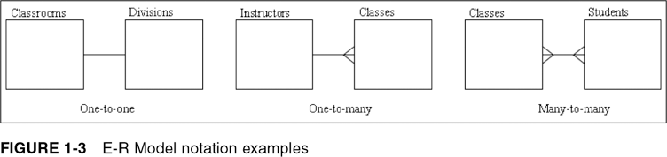
E-R Model Notation Examples
11

Slide 12
One-to-One Relationship
Each occurrence of data in one entity is represented by only one occurrence of data in the other entity
Example: A book has just one ISBN and each ISBN is assigned to just one book
12

Slide 13
One-to-Many Relationship
Each occurrence of data in one entity can be represented by many occurrences of the data in the other entity
Example: A book can have just one publisher, but a publisher can publish many books
More important in relational databases.
13

Slide 14
Many-to-Many Relationship
Data can have multiple occurrences in both entities
Example: A book can have more than one author, and an author can write more than one book
Can not exist in a normalized database
14

Slide 15
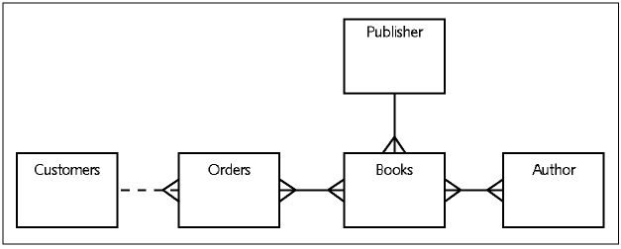
JustLee Example E-R Model
15

Slide 16
Database Normalization
Determines required tables and columns for each table
Multistep process (1NF, 2NF, 3NF)
Used to reduce or control data redundancy and data anomalies
16

Slide 17
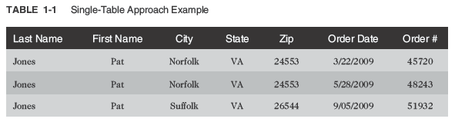
Database Normalization (continued)
Data redundancy (duplication) – having the same data in different places within a database
Data anomalies – data inconsistencies

Slide 18
Summary of Normalization Steps
1NF: eliminate repeating groups, identify the primary key
2NF: table is in 1NF, and partial dependencies are eliminated
3NF: table is in 2NF, and transitive dependencies are eliminated
Usually done by an experience DBA (database administrator).
18

Slide 19
Relating Tables within the Database
Once tables are normalized, certain tables are linked logically
Tables are linked through a common field
A common field is usually a primary key in one table and a foreign key in the other table
19

Slide 20
Relating Tables within the Database
Primary key – a single field that identifies each record uniquely (one-to-many relationship)
Composite primary key – when more than one field are necessary to identify each record uniquely
Foreign key – in a secondary table it defines the relationship with other tables that have primary keys. (one-to-many relationship)
20

Slide 21
JustLee Example E-R Model
UNNORMALIZED DATABASE
21

Slide 22
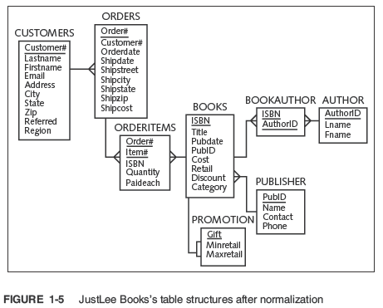
NORMALIZED DATABASE (no many-to-many relationships)

Slide 23
Structured Query Language (SQL)
Data sublanguage
Used to:
Create or modify tables
Add data to tables
Edit data in tables
Retrieve data from tables
ANSI and ISO standards
23

Slide 24
JustLee Books Database
NOTE: Be sure you understand the purpose of the tables in the JustLee database (pages 14 & 15).
Assumptions
No back orders or partial shipments
Only U.S. addresses
Completed orders are transferred to the annual SALES table at the end of each month to enable faster processing on the ORDERS table
24

Slide 25

The Client/Server Architecture
PC-based client SQL IDE
AWS Cloud-based Oracle Server

Slide 26

Loading the JustLee Database
Copy / Paste the contents of JLDB_Build.sql to the SQLDeveloper IDE and build the JustLee database.
CREATE TABLE Customers
(Customer# NUMBER(4),
LastName VARCHAR2(10) NOT NULL,
FirstName VARCHAR2(10) NOT NULL,
Address VARCHAR2(20),
City VARCHAR2(12),
State VARCHAR2(2),
Zip VARCHAR2(5),
Referred NUMBER(4),
Region CHAR(2),
CONSTRAINT customers_customer#_pk PRIMARY KEY(customer#),
CONSTRAINT customers_region_ck
CHECK (region IN ('N', 'NW', 'NE', 'S', 'SE', 'SW', 'W', 'E')));

Slide 27
Oracle 12c: SQL
End of Chapter 1
Overview of Database Concepts

